Slide 1
Facebook Interaction Dataset Analysis DSC 423 : Project Presentation
Team : DATA CREW
Members : Jiten Mishra , Erik Pak , Denvir Gama, Martello Pollock , Liang Tse Hsu

Slide 2
Problem Description
Understanding your customer base is one of the critical steps to business success, even on social media platforms. In marketing analysis, you hear performance metrics like Impression, Engagement, and Reach Etc., these metrics help us draw a precise strategy for social media and marketing. Also, these metrics will help to predict social media's impact on brand building.
As the result of this, the problem statement here is to find a relationship of all affecting variables on the Lifetime Post Consumer for a post made by a user, implementing a model that predicts the impact of posts using their characteristics to decide on publishing it on Social Media (in this case Facebook).
Data set
Our data comes from an anonymous cosmetics brand's Facebook page, which collects every social media performance metric specified for this Facebook page. It includes seven features known before post-publication and 12 features for evaluating post impact.

Slide 3
The Data set contains the following features :
Identification—features that allow identifying each individual post
Content—the textual content of the post
Categorization—features that characterize the post
Performance—metrics for measuring the impact of the post (or the impact of the page, in the case of “Lifetime Post Consumers”)

Slide 4
Data set contains the following variables:
Page total likes : No of people who liked the page
Type : Type of content Link/Photo/Status/Video
Category : Manual content characterization: action (special offers), product (direct advertisement,) and inspiration (non-explicit brand related content)
Post Month : Month the post was published [1 – 12]
Post Weekday : Weekday the post was published [1-7]
Post Hour : Hour the post was published [0-23]
Paid : Paid /non paid [1/0]
Lifetime Post Total Reach
Lifetime Post Total Impressions
Lifetime Engaged Users
Lifetime Post Consumers
Lifetime Post Consumptions
Lifetime Post Impressions by people who have liked your Page

Slide 5
Variable Continued …
Lifetime Post reach by people who like your Page
Lifetime People who have liked your Page and engaged with your post
Comment : Total Comment on the post
Like : Total like on the post
Share : Total Share of the post
Total Interactions : Sum of Comment+Like+Share
Data Cleaning:
For our model analysis we have removed all the performance metrics except the Lifetime Post Consumers.
Comment, like and share are removed from data because we have total interaction.
Created dummy variables for Type, Category and added to the data set by removing the original columns.

Slide 6
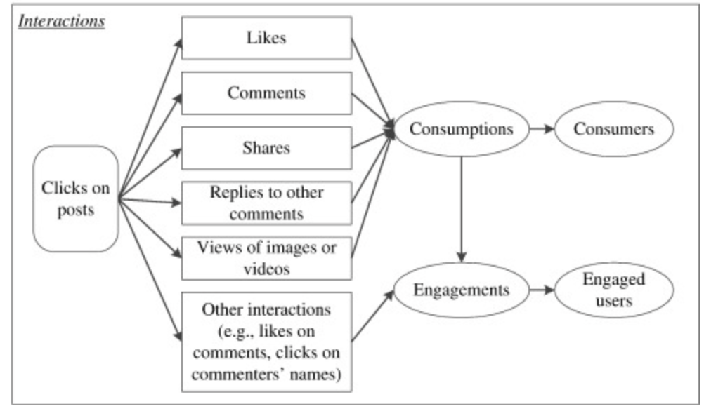
Interaction criterion of a post

